Slide 1
Smpl.
A Smart Electronics Startup
Innovation for the Future
19BCE1462 – Jessenth Ebenezer
!9BCE1607 – TEJAS V
19BCE1703

Slide 2
Background
Impulsive Tech Presents: Smpl.
Home automation has been quite a trending space in the consumer electronics industry in recent years, with the advent of smart devices like google home, amazon echodot and so on, with all major players investing millions into research in embedded systems and Internet of Things, its market recesses have spread far and wide even to third world countries.
While there are many competing vendors in this space, there are issues with the current state of home automation including a lack of standardized security measures and deprecation of older devices without backwards compatibility.
Our goal is to design and develop a feasible product that allows for remote automation of appliances externally and can be interfaced with an easily accessible device such as a smartphone or a computer with as little of a learning curve as possible to cover the consumer electronics space of the common man

Slide 3
Why should this be a thing?
Need for more efficient operation of household electric appliances
The all too familiar scenario of a busy start to your working day leading to you forgetting to turn off the clothes iron at home after use can not only prove to be a great loss of energy, but a dangerous fire hazard as well.
Have you ever wondered how much it really costs to run your appliances? Or considered upgrading to more energy-efficient models, but feel unsure about which appliance will give you the biggest savings?
That moment when you’re returning home after a long and tiring day at work in the sweltering heat of an Indian summer, wouldn’t it be nice if you could get your home air conditioning on and the temperature just right for you to drop straight into bed?
A smart plug solves all of these problems- and about 38 more and makes your regular appliances all beautifully connected into a neat interface that you can switch on or off at will with a click of your finger, schedule timings, track energy consumption in real time and so much more

Slide 4
Market Analysis
Is this really feasible?
North America secures the leading position in the global smart plugs market due to the presence of pioneer brands.
The region is a fast and early adopter of rising home automation technologies.
Rising economies in Asian nations such as China, Japan, and India are anticipated to experience a remarkable growth.
Product, service, and price-Keeping this in mind there can be a fully devised strategy that can be implemented.
There is no major use for the service part here as it is a one time sale that is done. So the product and the price is the major factor to focus upon. The USP of Smpl. is based on this and will be discussed further.

Slide 5
Domain
Consumer electronics has become a major part of the embedded domain as new products come into the market.
Creative ideas with great aesthetics are the need of this field.
A WiFi based Smart Plug is pretty much a game changing idea in the field with the ability to control and set timers to any AC appliance at home with your mobile device.
This can be marketed to a very broad audience who are in need of simplifying their daily lives.
Some of the current players in the dominant market (Canada, the United States) are D-Link Corp, Belkin International Inc., Etekcity Corp., EDIMAX Technology Co. Ltd., iSmart Alarm Inc., Panasonic Corp., Leviton Manufacturing Co. Inc., TP-Link Technologies Co. Ltd. SDI Technologies Inc.
As we can observe, there are start-up companies as well as big corporations all with a sizeable market share even in a space of rapid growth

Slide 6
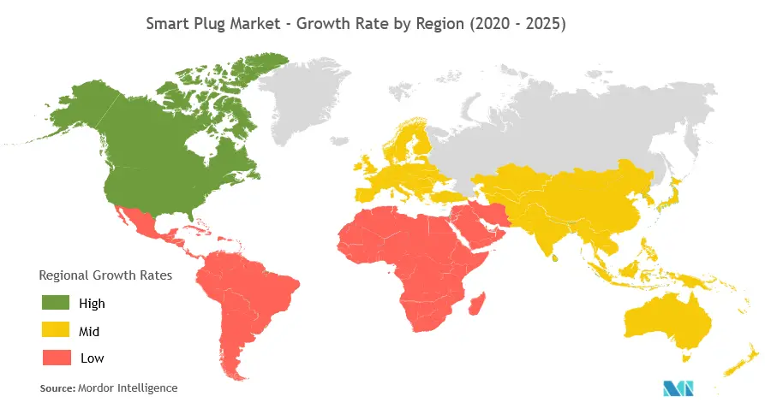
Target Demographic
Our main target demographic is the Indian Consumer Electronics Market due to its still-fresh entry into the smart plug market through Amazon’s Smart Plug launch in Mid 2020

Slide 7
Competitive Landscape
Why India? What are the current players? Is it worth attempting to grab a market share in the midst of conglomerates like Amazon?
In September 2020, Amazon launched its Smart Plug in India in its smart-device lineup.
The Smart Plug has been designed for the Indian market.
It utilizes a 3-pin socket design, supports a 6A power rating, and a state retention feature that ensures that appliances go back to their last state (on/off) in case of a power outage and resumption.
The Amazon Smart Plug is priced at INR 1,999 in India and can now be purchased on Amazon India and at select Croma and Reliance Digital outlets. Hence, as a relatively new thing in the country, Impulsive tech has a lot of scope in being pioneers of this tech.

Slide 8
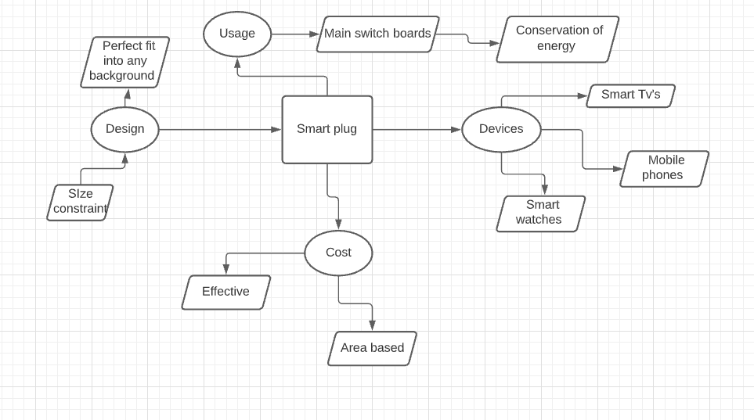
Smpl. – Smart Plug
What exactly is it?
Technically known as a power-point adapter, It is connected to a regular socket and has a socket where any electrical appliance can be connected to

Slide 9
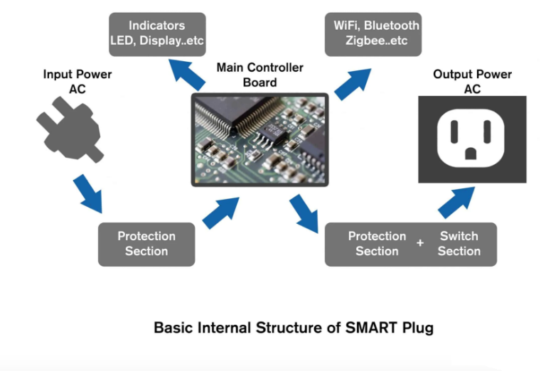
Smpl. – Smart Plug
The Technical Jargon
A smart plug’s Main Board consists of a microcontroller that is connected to an LED that denotes the status of the smart plug. Also, it will have the control of an antenna which will get your commands through Wi-Fi. Based on your received commands, the microcontroller will turn on or off the power output line through an electrical relay.
Moreover, there is a small memory chip inside the main controller board to keep your schedules. The microcontroller is programmed by us to check for scheduling while turning on or off the power output line as mentioned before

Slide 10
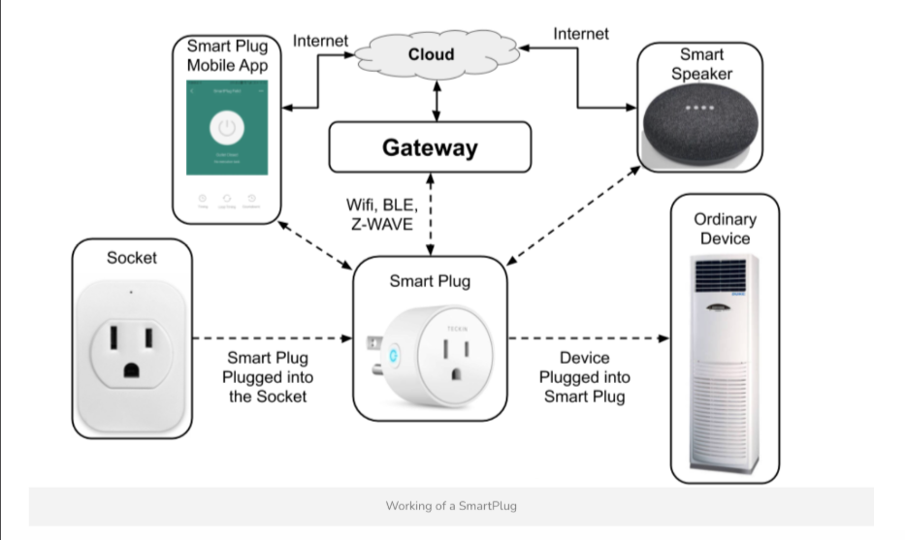
Working of a smart plug socket
All smart plugs have safety features in their power input and output lines.
Basically, there are fuses that will burn out at larger current values.
The mobile app is designed to communicate with your smart plug through your home WiFi and can be used to set timers or just switch them on or off seamlessly integrating into the home space

Slide 11
Marketing Strategy
How are we bringing this to you?
Smart Plugs can be given heavy exposure with targeted ad spending once we have enough backers on the project via Instagram, Facebook, etc. along with demo and tutorial/life-hack videos produced and promoted for the same.
The main marketing strategy of the Smart Plug offline is done at the points of purchase at retailers such as Croma etc with flyers etc. along with booths and marketing agents passing on information with demos etc.
Orders can be placed via the online store on our website or via popular e-commerce sites where our product will be listed in the future, such as Amazon, etc.
The application for the smart plug will be available free of cost on the iOS/Google Play stores to ensure easy access and will also contain modules with the aforementioned videos to garner customer interest in case they have not purchased a unit yet

Slide 12
THANK YOU
ANY QUESTIONS?

